Slide 1
Inventory Management System
A Smart Software Solution for Efficient Shop Management
Presented by
Nafees Montasir
Kazi Saiful Jamil
Farhanul Haque Promit

Slide 2
What is this
A software application or process used to track, manage, and organize a business's goods and materials throughout the supply chain.

Slide 3
Why need this
A business needs an Inventory Management System to save money and avoid mistakes.

Slide 4
How it helps
It acts like a digital brain for a business, making sure you never run out of stock, never waste money on extra items, and always keep your financial records perfectly organized.

Slide 5
Dashboard & Profile
Smart Alert system
Features
Dual-Category Classification
Financial Control
Core Inventory Actions
Dynamic Discount Management

Slide 6
Concept of OOP
Class & Object | Product, PerishableProduct, NonPerishableProduct & Inventory
Encapsulation | Private data members with public getters / setters (getId(), setPrice())
Inheritance | PerishableProduct and NonPerishableProduct derive from Product
Abstraction | Pure virtual functions display(), getType(), and serialize()
Polymorphism | display() and serialize() overridden in derived classes
Friend Function | applyDiscount() accesses private data member price directly
Dynamic Memory Allocation | new / delete for dynamic allocation and deallocation of product objects
Exception Handling | try / catch with custom exception class InvalidInputException for safe inputs
File Handling | ofstream / ifstream to save & load inventory data to/from text file

Slide 7
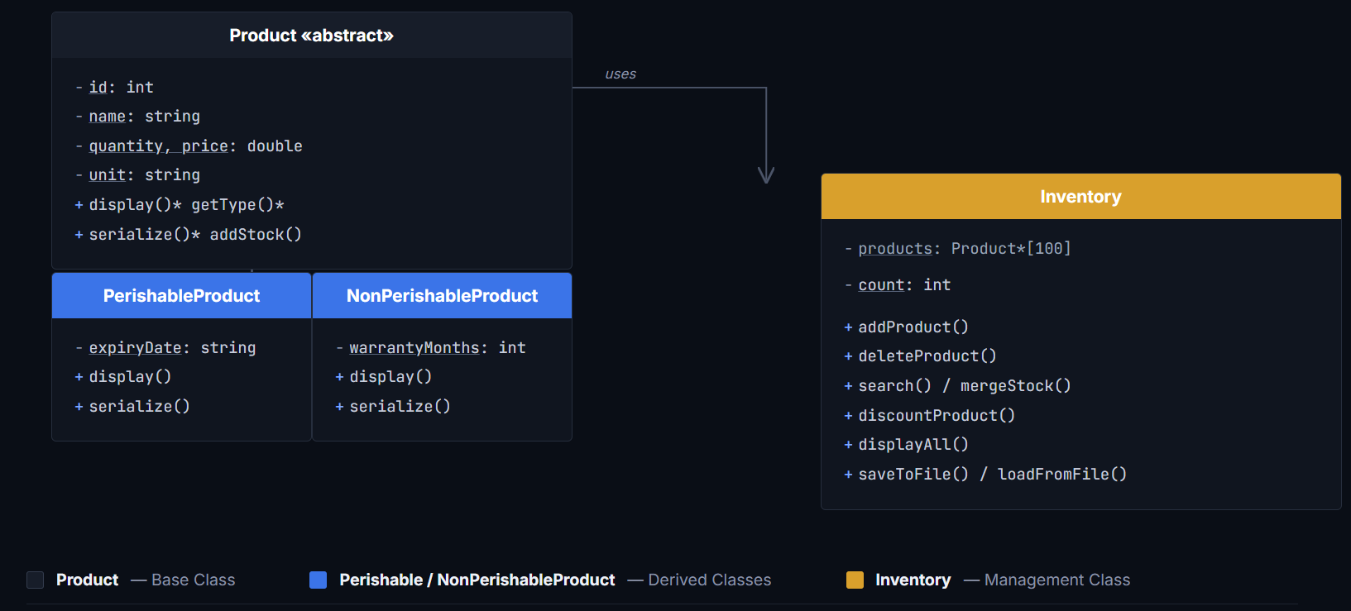
Unified Modeling Language (UML)

Slide 8
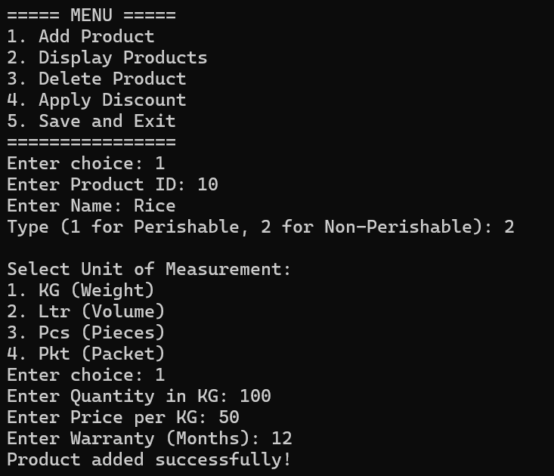
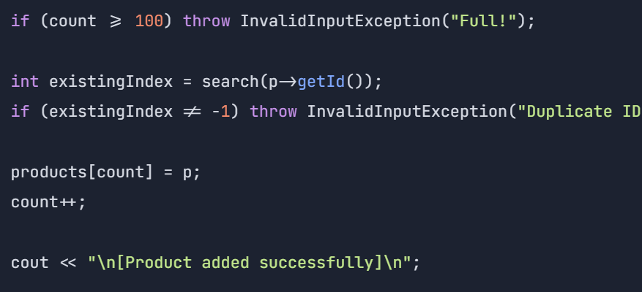
Proggrame Demonstration
Add Product

Slide 9
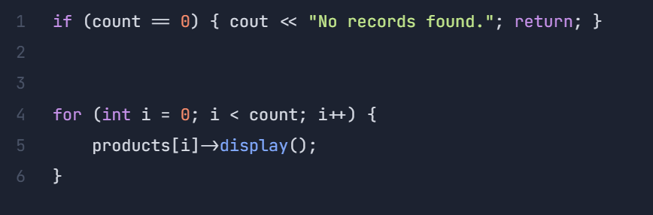
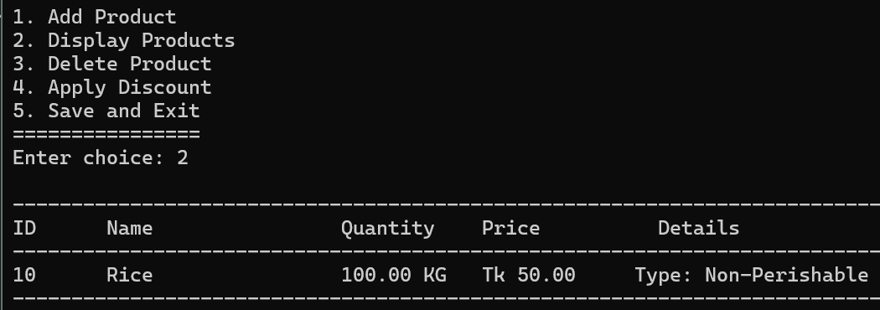
Display Product

Slide 10
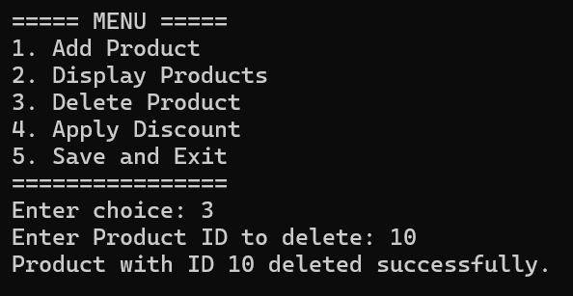
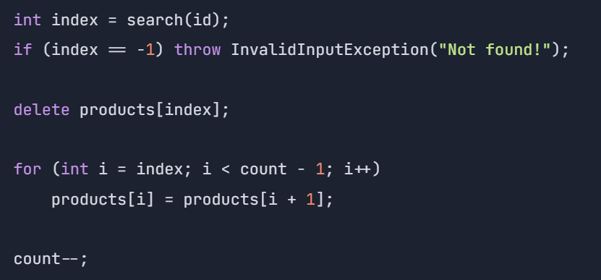
Delete Product

Slide 11
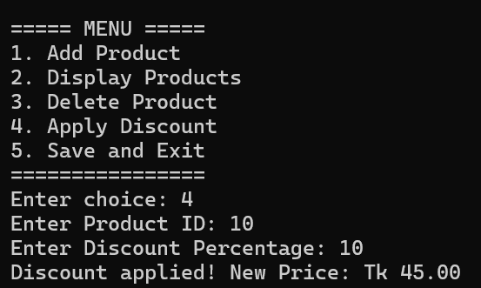
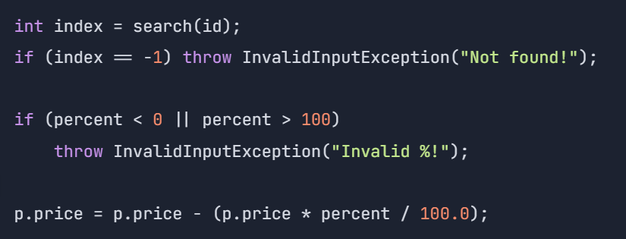
Apply discount

Slide 12
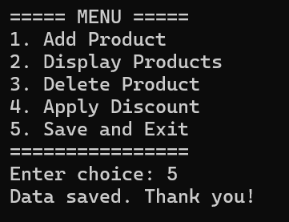
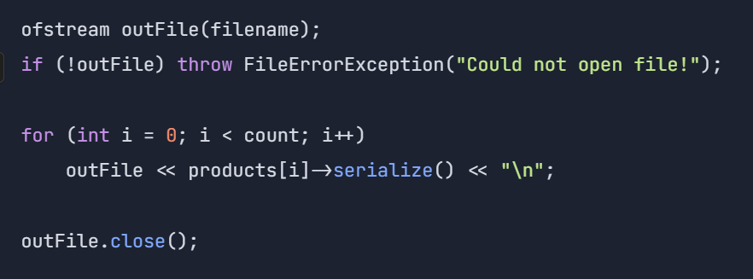
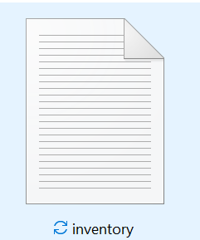
Save and Exit

Slide 13
Thank you

